Slide 1

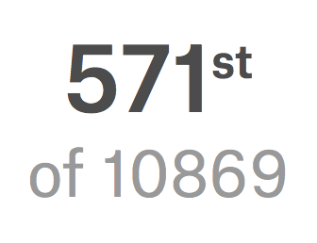
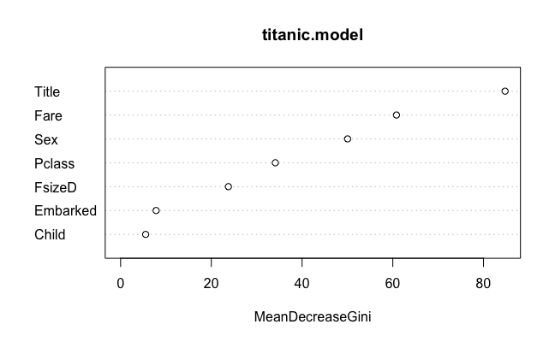
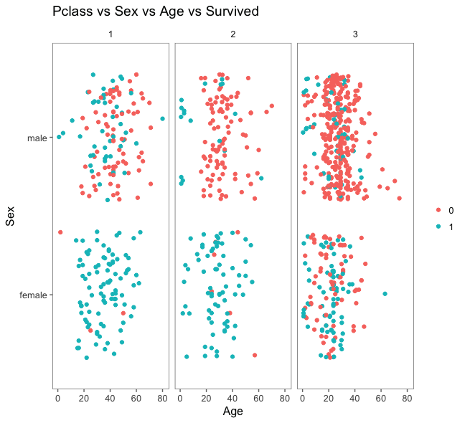
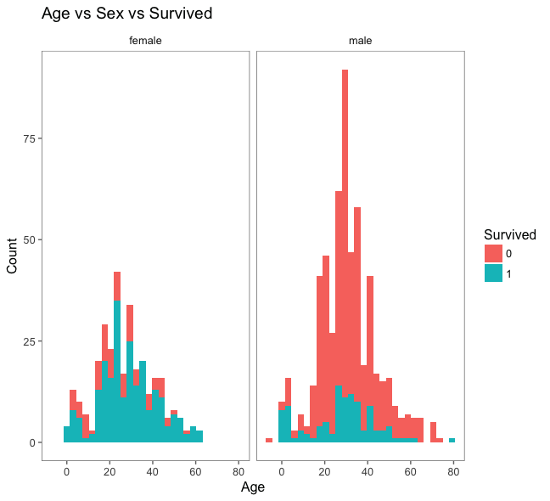
MATH 4432 Mini-Project 2: Will You Survive From Titanic?
Haojie WANG
Department of Civil and Environmental Engineering, HKUST
Kaggle Titanic Project
@Haojie W
Rank 571st of 10869, Top 6%
https://www.kaggle.com/hjwang
1. Introduction
3. Feature Engineering
5. Analysis & Conclusion
The sinking of the RMS Titanic is one of the most infamous shipwrecks in history. Now on Kaggle, over ten thousand teams are working on predict the survival based on the Titanic Database.
Like many of them, this project is also dedicated to find the secret of how the survived chance is linked with your personal information and how to increase the chance of survival.
Guidelines:
It is easy to find out that knowing how people formed groups (like family) or belonged to certain groups (like children) is key in this data set. For example, family tends to flee together and people who with officer title will help people evacuate so they will have similar survival chance.
Create variables “Title”, “Fsize(D)” (family size) and “Child”:
For Title: Titles are extracted from the variable “Name” to form 6 groups which are “Miss”, “Mr”, “Officer”, “Master”, “Mrs”, ”Royalty”to identify the identity of people.
For Fsize(D): Variables “parch” and “sibsp” are added together to calculated the family size (“Fsize”) and further divided into 3 groups (“FsizeD”) “single”, “medium”, “large” according to the value of “Fsize”.
For Child: passengers are divided into two groups, which are “child” and “adult” to consider the age factor in model for better training results.
By analyzing the Titanic data using prescribed machine learning methods, several conclusions can be drawn from this project:
Women are more likely to survive in this disaster, especially those who can afford class first and second tickets (Rich women).
Children (Age<18) and those people with royalty titles are also have a higher chance to live.
Most third class men died in this disaster, while medium size family are more likely to live.
From the importance analysis of random forest model, “Title”, “Fare”, “Sex” and “Pclass” are the most four important predictors.
Hence, to answer the question in introduction, if you want to increase the chance to live in such a disaster, please buy a ticket as expensive as possible, and better travel with you family to form a 2 to 4 person’s medium group. Also, being rich and becoming a noble will definitely help a lot!
2. Data Preprocessing
Data cleaning for missing values
By analyzing the records, there are four features with missing data: I. Fare values: 1 passengers missing; II. Embarked values: 2 passengers missing; III. Cabin values: 77% missing. IV. Age values: 20% missing. Hence, following actions are taken:
For fare and age missing value, linear regression model are trained to predict the missing values, respectively.
For embarked missing values, it is replaced by most common value which is also the median ”S”.
For Cabin missing values, the missing proportion is too high. To avoid adding to much noise to the dataset, this feature is not considered in model training and prediction .
4. Model Design and Predict
Fig.3 MeanDecreseGini plot for ramdon forest model
Methodology
Logistic regression [Submitted score:0.794]
Logistic regression was first used to be trained with 70% of training samples and then tested with other 30%, shows an accuracy of 0.824 with precision of 0.831, recall of 0.92, and F1 value of 0.873. It can be regarded as a good candidate model.
Gradient boosting machine (GBM) [Submitted score:0.809]
GBM was then used with shrinkage parameter λ equals to 0.01 and 0.001. Under two different λ values, parameter tuning was carried out to adjust parameters (e.g., n.tree, depth, etc.) for better performance of model with R package “caret”. When test with training data after tuning, the accuracy values reaches 0.827 and 0.823 for λ equals to 0.01 and 0.001, respectively.
Random forest [Submitted score:0.813]
Random forest was then applied to this problem with predictors: “Pclass”, “Child”, “Sex”, “Title”, “FsizeD”, “Fare” and “Embarked”, and the accuracy reaches 0.826 for the model with training data.
6. References & Acknowledgements
James, G., Witten, D., Hastie, T., & Tibshirani, R. (2013). An introduction to statistical learning (Vol. 112). New York: springer.
Space Limited, for acknowledgements, please refer to source codes.
6. Contact Information
Haojie WANG (20371572)
PhD Student
Department of Civil and Environmental Engineering, HKUST
Tel: (852) 5422-9876
Email: hwangbw@ust.hk or h.wang@connect.ust.hk
Fig.1 Scatterplots of Pclass, Sex,
Age and Survived
Fig.2 Histgram of Sex, Age and Survived

